Slide 1
Impact and Relevance of Business Schools: Empirical Perspective 9th Deans and Directors Conference, National Business Education Accreditation Council by Muhammad Moazam Shahbaz CEO, Naqeebz

Slide 2
To have an Impact of Business Education, its Relevance is Important while there is a huge disconnect between
Academia and Industry

Slide 3
Opinion is divided!

Slide 4
Business world is changing fast &
getting complex

Slide 5
There are no fixed answers to
complex problems in VUCA times

Slide 6
Employers expect from business schools to produce ‘Ready for Employment’ graduates

Slide 7
78% of Employers in Pakistan are NOT SATISFIED with the Quality of Graduates
Graduate Employability: Employers’ Perception Survey Report 2018 by Naqeebz Consulting Survey 2018

Slide 8
Respondents’ Profile
By Industry

Slide 9
Respondents’ Profile
By Designation / Job Role

Slide 10
Respondents’ Profile
By Employee Size Base of the Participating Company

Slide 11
Reasons for Dissatisfaction

Slide 12
Reasons for Satisfaction

Slide 13
Top-Ten Soft Skills

Slide 14
Highly preferred technical skills

Slide 15
What Business Leaders say? Responses gathered exclusively for today’s conference

Slide 16
Questions asked
What do you think that the education and training being given to students in business schools is relevant to the needs of organizations / business world?
What are the important skills which business graduates must have? And what do you think are business schools enabling students to develop these skills during their studies?
Is business education having any impact on businesses in Pakistan? Are business graduates able to contribute to the growth of businesses?

Slide 17
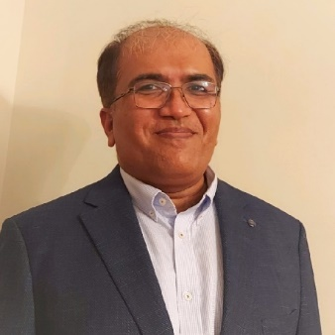
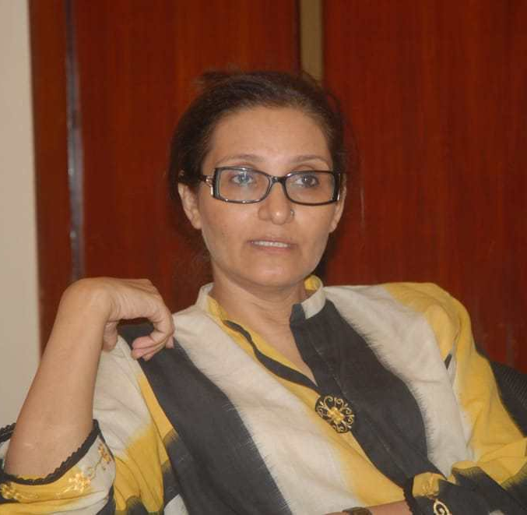
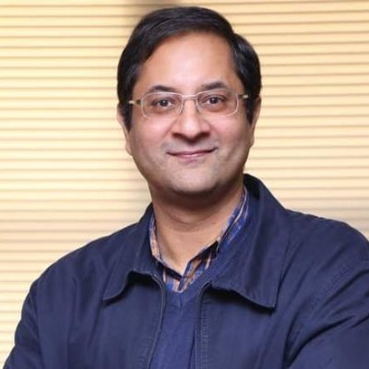
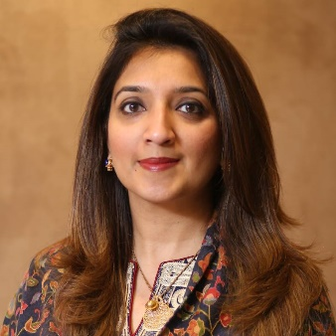
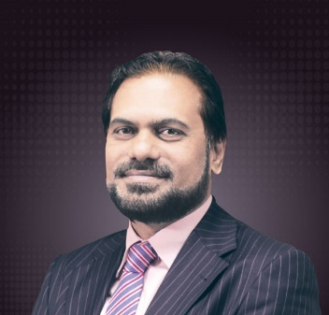
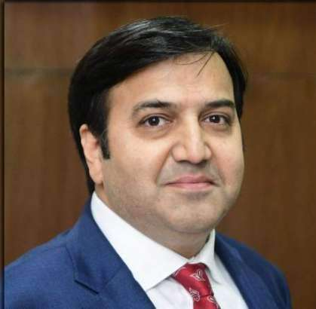
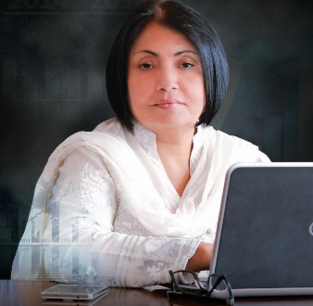
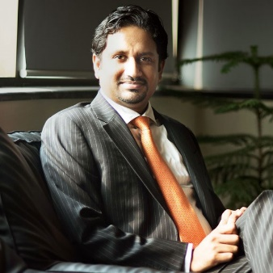
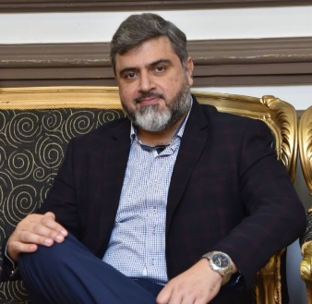
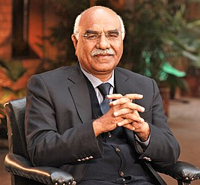
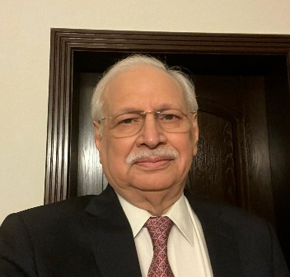
Ashaar Seed
Chief HR Officer
KIA Lucky Motors
Naila Bhatti
MD / CEO
Mitchells Fruit Farms
Omar Farooq
CEO
Interwood Mobel
Fatima Asad-Said
CEO
Abacus Consulting
Abdul Wahid Qureshi
CFO / Company Secy
Berger Paints
Mian Kashif
CEO
Chenone Stores
Tahira Raza
CEO & President
First Women Bank Ltd
Abbas Ali Mirza
CEO
Realcom
Tayyab Qureshi
CEO
Roshan Packages
Khalid Nabeel Butt
Chief HR Officer
Treet Corporation
Haris Bin Naseer
Director
Infotech
Adnan Mahmood
Chief Marketing Officer
Super Crisps / Tripple EM
Dr. Amjad Saqib
CEO
Akhuwat Foundation
Faisal Mushtaq
COO
Mcolson’s Pharma
Adil J. Mansoor
Chairman
Call Courier / Excel Group

Slide 18
Consolidated Feedback 1/2
Other than top-tier Universities, students are not being prepared for the corporate world. Top business schools are for-sure contributing to the growth of corporate world
Students are not being given real-corporate world examples during their studies. Their commercial awareness is inadequate
Critical thinking, analytical skills, emotional intelligence and other key skills are being ignored

Slide 19
Consolidated Feedback 2/2
University graduates are most suited for MNCs not for SMEs, there is less impact of business education on SMEs
Other than marketing & sales, there are serious challenges in finding resources for supply chain, finance, production, import/export and international business
It is challenging to cover every aspect of training and education. What we teach today becomes quickly obsolete, or is thrown over by new theories, practices and inventions.

Slide 20
Suggestions

Slide 21
Ensure active participation of Industry reps in the Board of Studies
Inclusion of a good percentage of visiting faculty from the industry
Teach more local case studies
Deploy students in the field for a year or more
Focus on developing soft-skills
Discourage rote learning by improving assessment methodology

Slide 22
The world’s first marketing book around market-specific case studies by Naqeebz and Kotler Impact

Slide 23
Thank you!
Moazam@naqeebz.com
0321 446 2359

